Slide 1









National Symposium
in observance of
The International Day of Persons with Disabilities
Title: Empowering Persons with Disabilities through Enhanced Accessibility and Digital Inclusion
Theme: Accessible Infrastructure & Digital Inclusion
Submitted by: Access Bangladesh Foundation
Date: 4th December, 2025

Slide 2




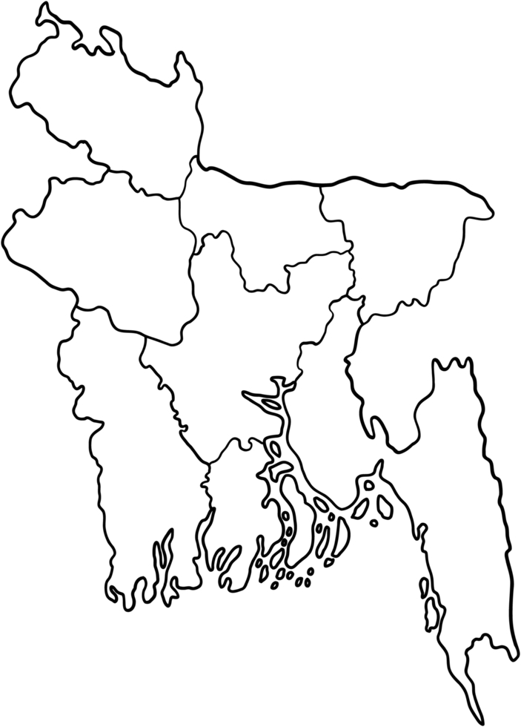







Organizational Overview
Access Bangladesh Foundation | National level OPD | 4th January 2008
Vision 💡
Mission 🎯
Building an inclusive society where children, youth, women, men with disabilities as well as other marginalized groups can participate equally in all areas of life.
Promoting equity for children, youth, women, men with disabilities as well as other marginalized people through inclusive education and skills, entrepreneurship development and wage employment, arts, culture and sports, health, SRHR and mental health services, ending GBV, legal assistance, DRM and CCA and ICT.
Core Working Areas
Geographical Coverage
29 districts in 8 divisions partnership with 65 OPDs
Inclusive Education
Inclusive Livelihood
Digital Inclusion
🏠 Headquarter in Savar, Dhaka
3 project offices
Dhamrai
Shyamnagar and
Chilmari, Kurigram
Accessible Infrastructure
SRHR
DRR and CCA
Access to Justice
Research, Campaign
& Advocacy
Advisory Services

Slide 3
Focus and Thematic Areas
Thematic Title: Empowering Persons with Disabilities through Enhanced Accessibility and Digital Inclusion
Theme of this Paper: Accessible Infrastructure & Digital Inclusion
Focus & Thematic Areas
Accessibility Assessment, renovation and improve accessibility of Information & Feedback Centers in humanitarian context
Promote digital inclusion through skills development and employment generation for youth and women with disabilities
Accessible online learning and
e-commerce platforms

Slide 4
Major Project on Accessible Infrastructure: Renovation work in 18 Information and Feedback Centers in Rohingya Camps and Host Communities for making them more accessible to persons with disabilities
Working Model: Accessibility Assessment, Renovation and Improve Accessibility
Conduct accessibility audit of 18 IFCs with universal design guidelines, BNBC 2020
Engage experienced technical persons (Civil Engineers, Informational Accessibility Expert, Disability Inclusion Expert) and different types of disabilities
Prepare comprehensive report with findings and actionable recommendations with BoQ and technical drawing
Renovated IFCs using locally made, context suited, easily available, cost effective and sustainable materials
Infrastructural features installed- Wooden Ramps, Tactile block, Non-slippery floormate, Doors with D-shape handle, Height adjustment of switch box, Accessible toilet facilities (grab bar, vertical bar, bib cock, pillar cock), Locally crafted brass metal emergency ring bell in toilets with a connected rope
Informational features: Wooden Facility nameplates and informational and services documents in multilingual text: English, Rohingya, and Braille version

Slide 5
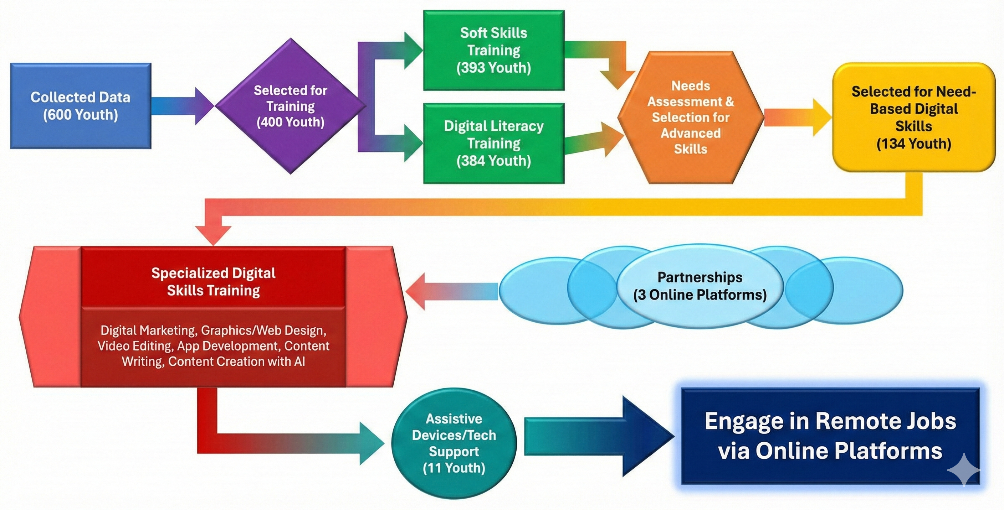
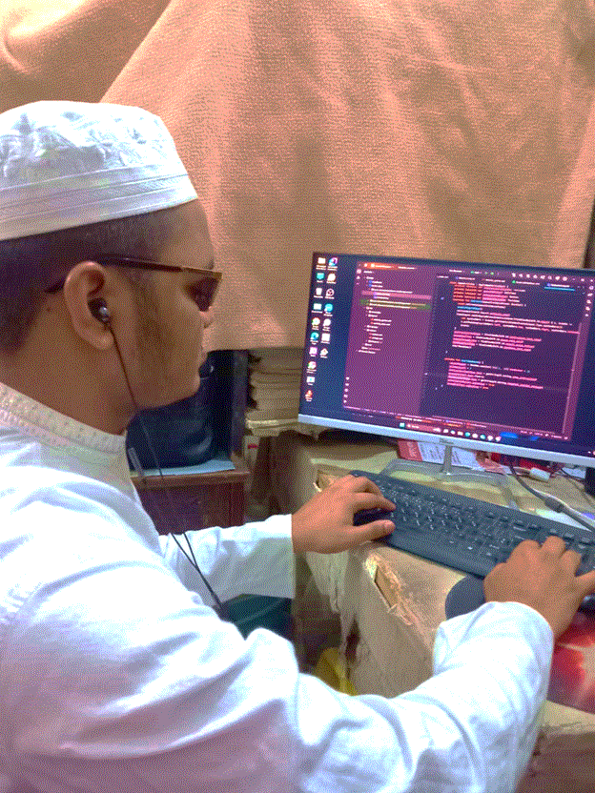
Major Project on Digital Inclusion: Making digital skills accessible for youth with disabilities and promoting their economic inclusion in Bangladesh Increase access of women entrepreneurs with disabilities in e-commerce platform
Working Model: Promote digital inclusion and skills training for youth with disabilities

Slide 6
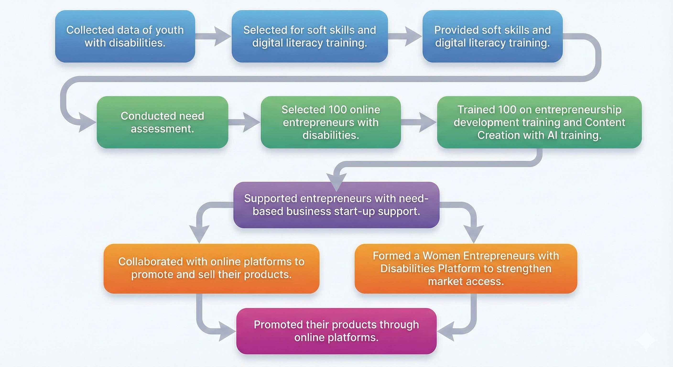
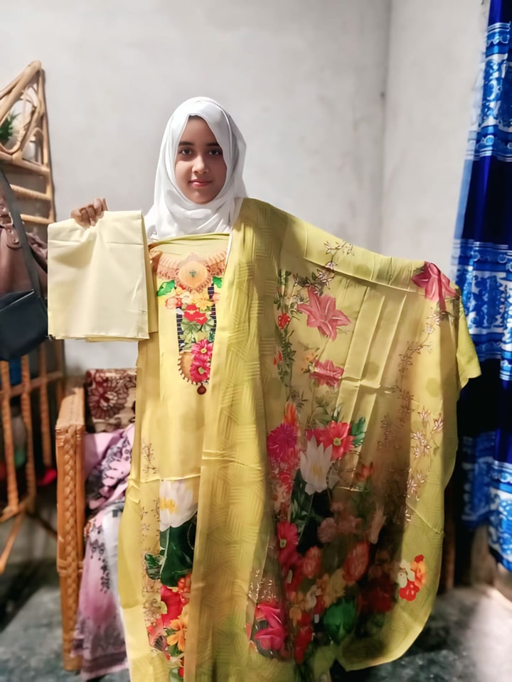
Working Model: Accessible online learning and e-commerce platforms

Slide 7
Key Achievement and Good Practices
Renovated UNICEF’s 18 IFCs with improved accessibility features, covering both infrastructural and informational aspects.
Used locally available and low-cost materials appropriate for the context (local craftspeople produced wooden ramps, nameplates, and emergency bells made of brass).
Developed multilingual and accessible information materials, improving access for Rohingya and host communities, individuals with lower literacy levels, and persons with different types of disabilities.
Introduced an online-based skills development system, enabling youth with disabilities including those with severe disabilities to access training from anywhere in the country.
Created online-based job opportunities for youth with disabilities, enabling them to work remotely and participate in the digital workforce.
Supported the creation of digital entrepreneurs with disabilities, enabling them to run online businesses and participate in the digital economy.

Slide 8
Collaboration and Partnership
Government: NGO Affairs Bureau, RRRC, Ministry of Social Welfare, a2i
Donor Agencies: UNICEF, Internet Society Foundation, APNIC Foundastion
OPDs: Strategic and Funding Partnership with 65 OPDs
Online training platforms: Creative IT Institute, ISD-Brac, & Learning Bangladesh E-commerce platforms: Daraz, WE
Media both electronic and print

Slide 9
Challenges
Theft and damage of infrastructure materials
Access to digital devices is limited for most persons with disabilities due to negative attitudes towards them and economic constraints.
Limited digital literacy and educational gaps hinder effective use of basic devices and internet resources
Social and cultural barriers affecting women with disabilities in entrepreneurship.
Limited skilled workforce for accessibility modifications
Lessons Learned
Community engagement is critical to protect and maintain accessible infrastructure
Comprehensive digital skills training must be combined with assistive technology support
Way Forward
Expand accessible service centers
Strengthen capacity of OPDs to monitor and maintain accessibility standards.
Scale up inclusive digital skills training youth and women with severe disabilities with assistive technologies
Improve e-learning and e-commerce platforms with accessibility features including captions, screen-reader support, and sign language
Advocate for the effective implementation of accessibility and digital inclusion policies

