Slide 1
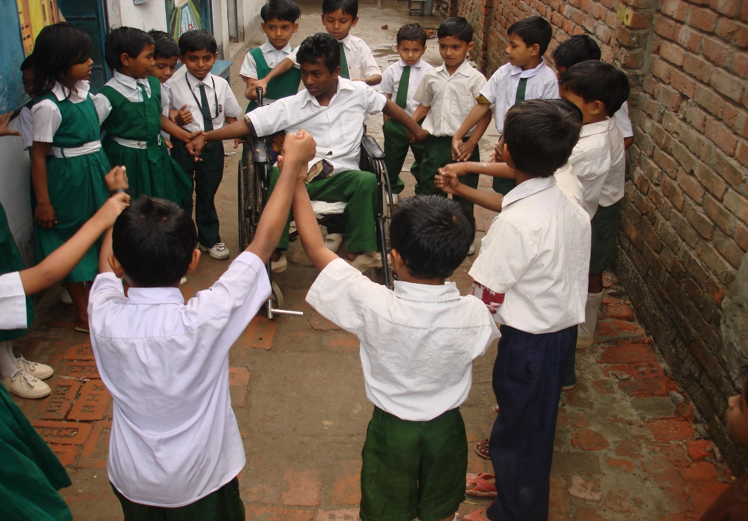

Community-Based Inclusive Child Protection:
Strengthening Caregiver Support, Community Engagement and Well-being of Children with Disabilities in Bangladesh
Presenter
Iftekhar Ahmed, Director,
Centre for Services and Information on Disability(CSID), Bangladesh

Slide 2
Background & Challenges
(Based on the UNICEF Funded project)
Children with disabilities face higher risks of abuse, neglect, and exclusion.
Poverty, communication barriers, and limited mobility increase vulnerability.
Lack of knowledge on disability inclusion among front line worker, caregivers.
Children with disabilities have low resilience to protect themselves from violence.
Caregivers sometimes don’t disclose the issue of sexual abuse to their children.

Slide 3
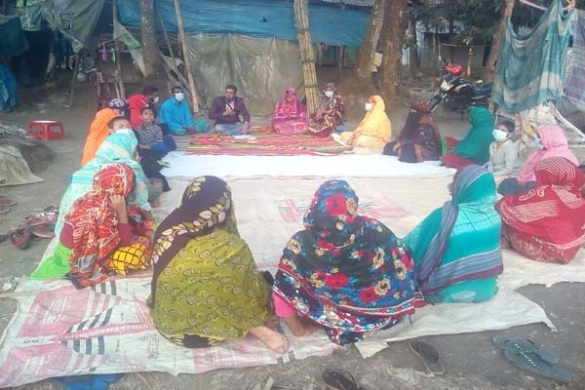
Caregiver Empowerment
Awareness on child rights, disability inclusion, SEA.
Psychosocial counselling and livelihood grants to strengthen family resilience.
Positive parenting reduces the risk of violence.
Strengthening knowledge on early identification and intervention.

Slide 4
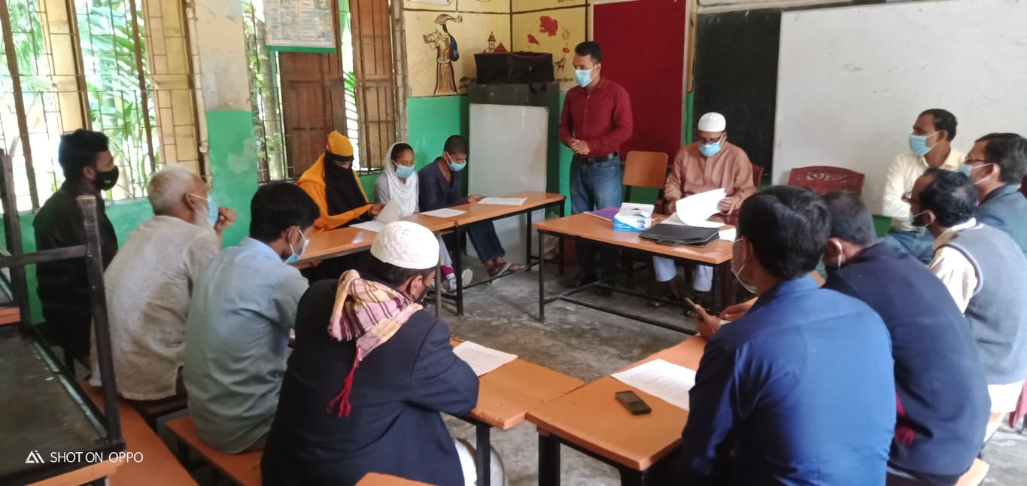
Community-Based Protection
Disability-Inclusive Community-Based Child Protection Committee(CBCPC).
Disability Inclusive Child Welfare Board.
Identification and referral of at-risk children including girls with disabilities.
Awareness campaigns and home visits.
Support for referral, inclusive education etc.
Knowledge building of teachers.

Slide 5
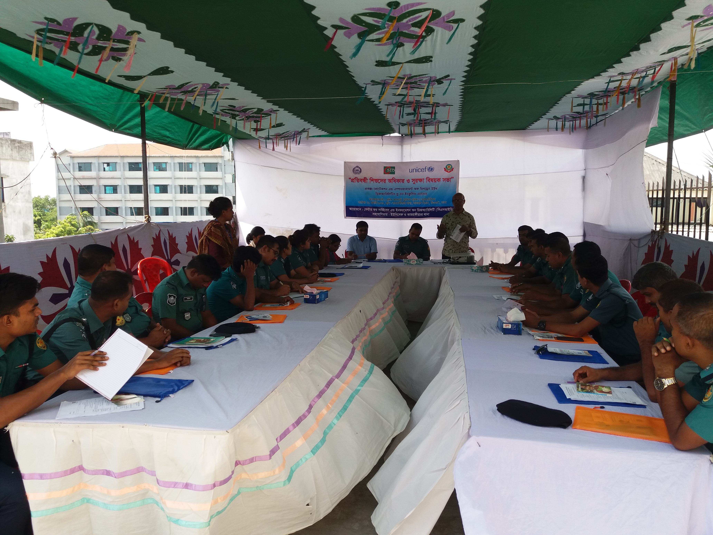
Strengthening Government Actors
Training social workers on disability-inclusive case management.---CSPB & APC
Coordination among social services, law enforcement, and judicial systems.
Capacity building of Child Helpline 1098 staff on disability
Disability Inclusive Child Affairs Desk at Police Station
Disability Inclusive Children’s Courts
Victim Support Centre-Limited accessibility, Specialized staff shortage, lack of awareness

Slide 6
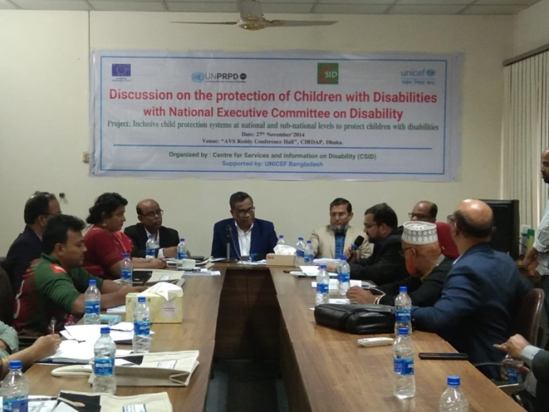
Strengthening DRPCs
Awareness among DRPCs members on the protection of children with disabilities.
Orientation on legal mandates based on UNCRPD and RPPD Act.
Joint workshops with DSS ,local government and OPDs.
Disability-sensitive data and monitoring.
Enhanced accountability and capacity.

Slide 7
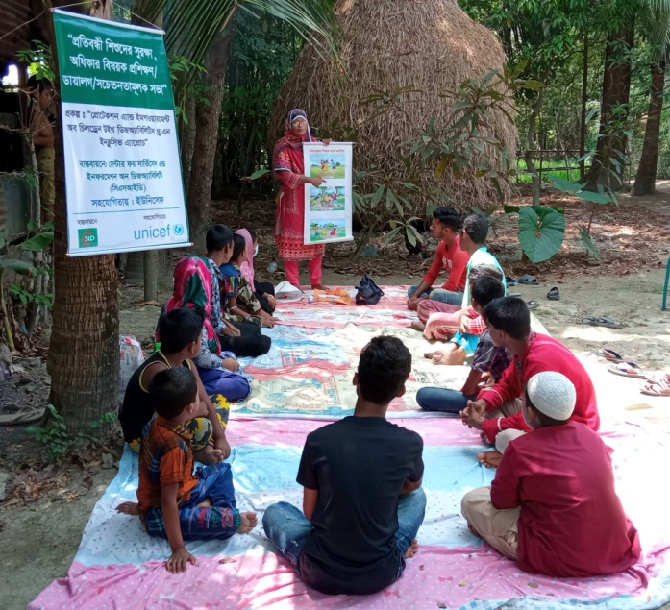
Child Well-being
Art, music, and sports for emotional well-being.
Disability Inclusive Child Protection Community Hubs (CPCHs).--APC
Improved confidence, participation, and school engagement.
Stronger community–government coordination.
Resilience Building of children with disabilities
Vocational training and light employment for adolescent with disabilities

Slide 8
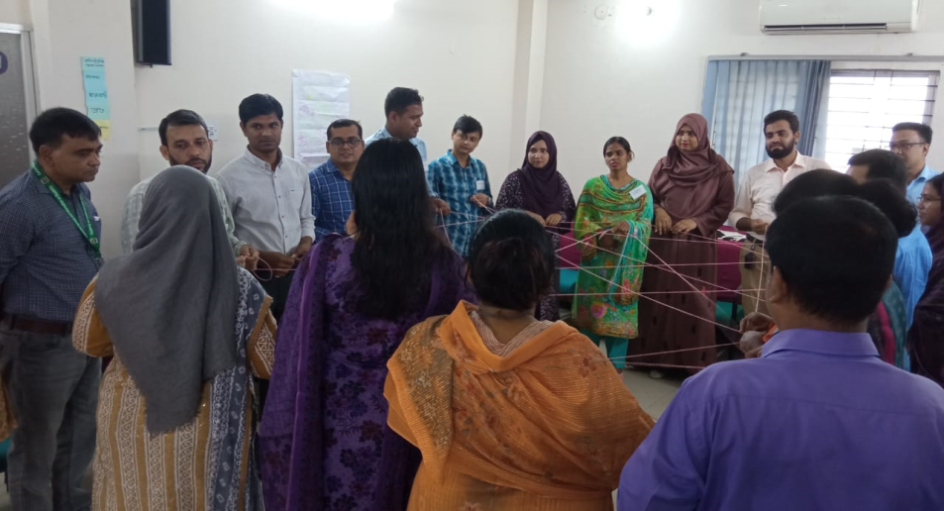
Conclusion
The CSID–UNICEF experience shows that coordinated, inclusive systems can ensure safety, dignity, and participation for children with disabilities that reduce the risk of violence.
Mass awareness on disability inclusive child protection system.
Inclusive child protection is strongest when caregivers, communities, and institutions work together.

Slide 9
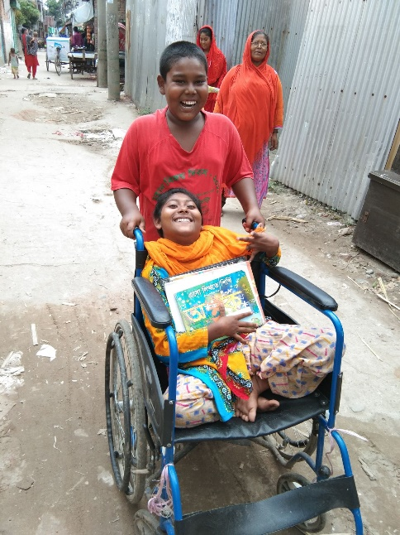
Thanks

