Slide 1









National Symposium
in observance of
The International Day of Persons with Disabilities
Presented by:
Md. Jahangir Alam
Senior Coordinator
Centre for Disability in Development (CDD)
Cell: +88 01711-225524
E-mail: jahangir.cdd@gmail.com, info@cdd.org.bd
Web: www.cdd.org.bd

Slide 2

Organizational Overview
Vision: An inclusive world where all persons with disabilities live with dignity
Mission: To contribute in creating a sustainable inclusive environment where persons with disabilities are meaningfully participating in the mainstream development process, on an equal basis with others
The Centre for Disability in Development (CDD) is a not-for-profit organization established in 1996 to develop a more inclusive society for persons with disabilities. CDD's mission is to address the exclusion of persons with disabilities from mainstream life by educating the community and enabling them to participate in society. The organization works in partnership with a network of over 350 organizations both nationally and internationally. CDD has received numerous awards and recognitions for its excellence in disability and development work. The organization's strategic plan for 2022-2025 aims to continue its mission of inclusivity and empowerment, with active participation from its staff, management, governance, partners, stakeholders, and program participants.
bringing hope, dignity and meaning to life

Slide 3
Major Ongoing Initiatives/Projects
To improve the access to mainstream and specialized education by learners with
disabilities.
To contribute to inclusive health and rehabilitation services for persons with
disabilities and other marginalized groups.
Enhance capacity of persons with disabilities, cares & their organizations on rights, participation, and access to services.
Create livelihood and income opportunities for persons with disabilities for a better, healthy life.
Strengthen local government capacity for disability mainstreaming in governance and service delivery.
Ensure accessible and equitable WASH facilities in both urban and rural areas.
Mainstream disability inclusion in DRR, CCA & humanitarian actions.
Promote inclusive humanitarian action in Rohingya camps and host communities, Cox’s Bazar.

Slide 4
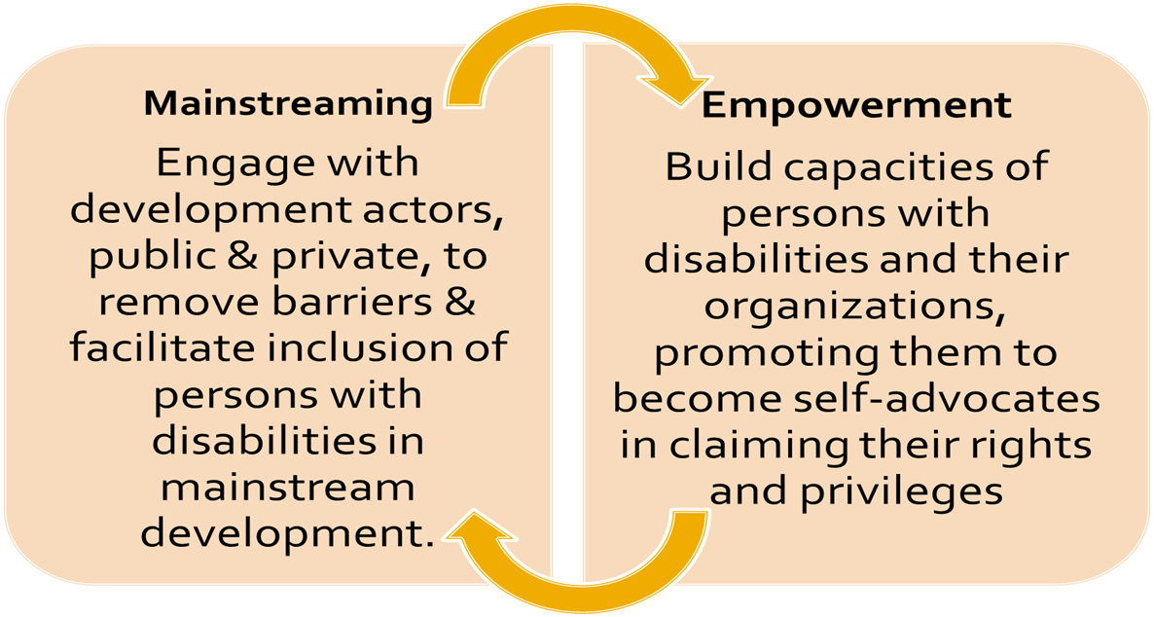



Working Approaches and Strategies
Implementation Approach:
Direct Implementation + Joint Implementation
Technical Advisory
Assessment
Capacity Strengthening
Resources
Inclusion Partner
Grants Management
Partner Organizations

Slide 5
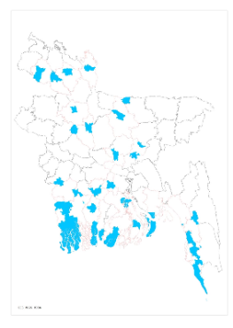






Geographical Coverage

Slide 6

Project Title
Inclusive Education Project:
Disability Inclusive Development
TO-45 (Shikhbo Sobai)
Strengthening systems for the enrolment, retention and support of children with disabilities at primary level of mainstream education in Bangladesh- Inclusive Education DID TO45

Slide 7
Project Duration: April 2022 to March 2026
Project Location: Narsingdi Sadar, Sirajganj Sadar,Taras, Sirajganj, 45 government primary schools
Project Target Population: Children Between 5 To 15 Years of Age ,Who Are Studying Under Inclusive Education. Also Children With Severe And Multiple Disabilities Who Need To Be Educated In Schools As Well As Learning Under Their Own Homebased Education Support.

Slide 8
Implementation Consortium
TO-45
FCDO, UKaid
Sense International
Sightsavers
ADD
CDD
GBS, Tarash
KPUS, Sirajganj
Papri, Narsingdi

Slide 9
Key Achievement and Good Practices
Key Achievements:
Successful Policy Influence at Upazila, District & National Levels
Improved School Accessibility and Inclusive Learning Environments
Strengthened Collaboration Between OPDs and Education Authorities
Enhanced Capacity of OPD Members
Enrollment Support for Children with Disabilities
Strengthened Referral Linkages and Social Protection Access
Joint Development of OPD Action Plans
Good Practices:
System-Strengthening Approach for School Accessibility
Meaningful OPD engagement for sustainable quality education
Local Resource Mobilization Using SLIP Funds
OPD Capacity Development as a Core Strategy
Community Awareness and Peer Motivation
Home-Based and School-Based Support Collaboration
Partnership With Local Service Providers
Joint OPD–Government Advocacy Model

Slide 10
Challenges and Lessons Learned
Challenges:
Persistent Social Stigma and Negative Attitudes
Inaccessible School Environments
Weak Identification and Referral Systems
Shortage of Trained Human Resources
Inadequate Assistive Devices and Learning Supports
Limited Financial and Technological Capacities of OPDs
Communication Barriers
Limited Disability-Responsive Policies at Local Level
Lesson Learned:
OPD Engagement is Essential for Sustainable Disability Inclusion
Capacity Building Strengthens Disability Rights Advocacy
Evidence-Based Advocacy Leads to Policy Action
School Accessibility Requires Multi-Dimensional Approaches
Partnerships Increase Impact for Children with Disabilities
Community Awareness Reduces Stigma
Local Resource Mobilization is Possible with Consistent Advocacy
System Strengthening Ensures Long-Term Inclusion

Slide 11
Collaboration and Partnership
Children with disabilities & Children with disabilities families
SMC, PTA and student council
Local and national level educational authorities
JPUF and LGI
District social service representative
Protibondi Sheba O Sahajjo Kendro
Other disability service providing agency

Slide 12





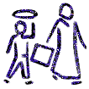




Programme Participants Reached
52%
54%
DIRECT
23,705
52,611
Total
94,820
71,115
16%
58%
Indirect
FDMN
FDMNs

Slide 13
Way Forward
Pilot Home-Based Education (HBE) provision for children with disabilities
Establish a robust, centralized database on children with disabilities
Strengthen Inclusive Education training and capacity development initiative
Ensure inclusive - universal designed infrastructure in all schools
Provision for inclusive slip fund
Provision for meaningful engagement for OPD’s and disability expertise agency
Provision for OPD engagement innovation fund
Provision for need based appropriate Assistive Device.

Slide 14
?
Thanks everyone

