Slide 1
Organizational Overview
BBDN was established as a non-profit trust by the Bangladesh Employers' Federation (BEF) in 2016, with support from the International Labour Organization (ILO) and was registered as an NGO in 2023.
Only national business and disability network with membership of employers and employers' associations, local / international disability & mainstream NGOs, civil society organizations, organization of persons with disabilities (OPDs) and support of development partners.
BBDN serves as a bridge between employers and job seekers with disabilities, strengthening employers’ disability confidence, improving candidates’ job readiness, and enabling better matching, while advancing the broader agenda of inclusive employment.

Slide 2
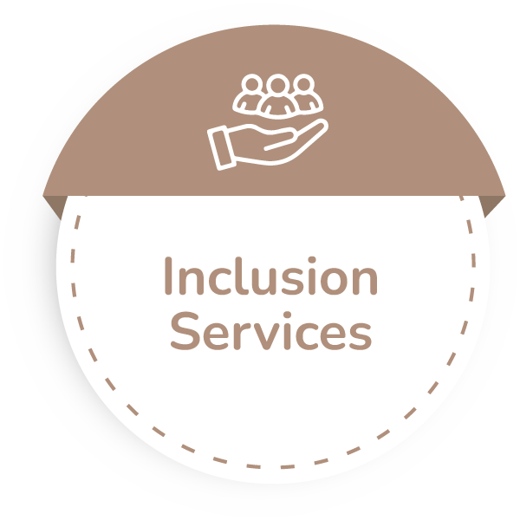
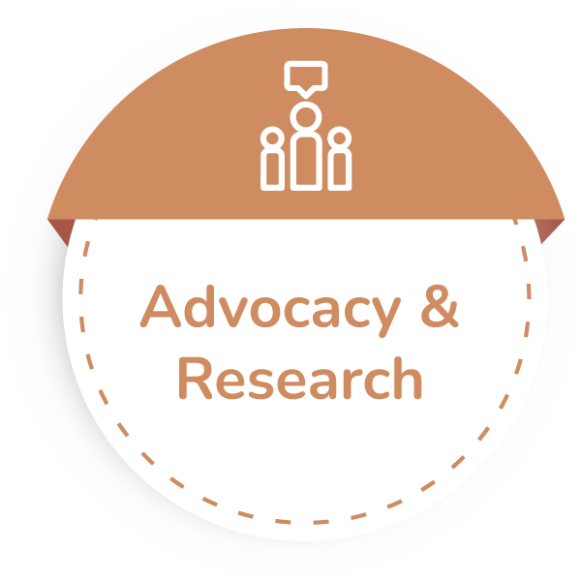


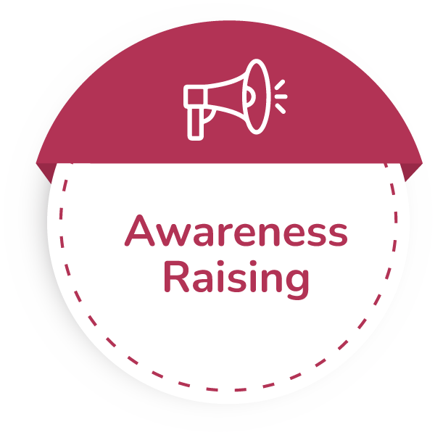

Focus and Thematic Areas
To facilitate a disability-inclusive workforce in Bangladesh
Thematic Areas

Slide 3
Geographical Coverage
BBDN operates from Dhaka, with countrywide reach through our resource members.

Slide 4
Major Ongoing Initiatives/Projects
Promoting Gender Responsive Enterprise Development and TVET Systems (ProGRESS), Funded by ILO
  Skills and Employment ; Policy Advocacy ; Entrepreneurship Development
Social Protection for Workers in the Textile and Leather Sector funded by GIZ
  Capacity building of factory management on Return to Work and Occupational Disease and Occupational Medicine
  Dialogue to facilitate policy and legal changes
BRAC Bank Aporajeyo Ami Initiative
  Skill building business compact model; national conference, job fairs, and disability sensitization of BRAC Bank employees

Slide 5
Key Achievement and Good Practices
800+ persons with disabilities, including women and girls, placed in jobs
540 trainees trained and mobilized across multiple trades and projects over the past five years.
1,250 corporate and TVET professionals sensitized on disability inclusion using an intersectional lens.
Advocacy leading to the introduction of a tax rebate proposal to encourage disability-inclusive workplaces.
Institutional partnerships formalized through MoUs between OPDs and TVET institutes in 10 districts
Supported 115 factories to establish Return-to-Work (RTW) systems and trained 103 healthcare professionals on Occupational Health and Occupational Medicine.
Advocacy efforts contributed to amending BLA Schedule 1 & 3, improving provisions on disability compensation and occupational diseases. (Ref: Bangladesh Labour Ordinance, 2025 )
A cross-sector platform established, bringing together employers, I/NGOs, and OPDs to share experiences, challenges, and best practices.

Slide 6
Challenges
Weak coordination between OPDs, TVET institutes, and business associations limits effective skills and employment pathways.
TVET institutes lack clear inclusion targets, dedicated budgets, and consistent data collection directly from persons with disabilities.
Persons with disabilities interested in self-employment face limited tailored support and resources.
There is no provision for return-to-work, meaning employers are not obligated to rehire workers who leave due to disability or illness under current BLA 2006.
Lesson learned:
Within any organization, a committed disability champion drives the strongest outcomes—shaping leadership attitudes, motivating management, and influencing policies toward meaningful inclusion.
Private-sector engagement is most effective when employers co-create solutions and view disability inclusion as a competitive advantage rather than a charitable gesture.
Proactive TVET institutions with sector-specific expertise are better equipped to deliver skills development that leads to real job security.

Slide 7




































Collaboration and Partnership
Founder & Premier Members : 22
General Members : 7
Resource Members : 14

Slide 8












Collaboration and Partnership
Strategic Partners: 12

Slide 9
Way Forward
Expand private-sector engagement by leveraging CSR funds for skills development and sensitizing more companies on disability-inclusive employment
Develop and dissemination of a policy brief on disability-inclusive skills and employment with actionable recommendations for government and private sector stakeholders
Advocate Amendments Section 22(1) of the Labour Act 2006 to align with the Rights and Protection of Persons with Disabilities Act 2013 - so every worker with disabilities is protected, included, and valued.
Following Bangladesh’s ratification of ILO Convention 155, BBDN is advocating for disability-inclusive OSH guidelines and strengthening employer capacity through targeted training.
Establish a nationwide platform for entrepreneurs with disabilities to provide business development support and services.

