Slide 1









National Symposium
in observance of
The International Day of Persons with Disabilities
Disability Insights from Labour Force Survey (DILFS) 2022 Bangladesh

Slide 2

Organizational Overview
Bangladesh Bureau of Statistics (BBS) is the National Statistics Office of Bangladesh with the responsibilities of generation, compilation, analysis, publish and authenticate the official statistics for Bangladesh legally mandated by the Statistics Act, 2013.
Historically BBS Collect disability data since inception through the population and housing censuses.
Sample Vital Registration System (SVRS) is the most frequent source in 1980 to estimate the disability statistics since 1980.
National survey on person with disabilities 2021 was the first ever standalone survey on disability related issues by BBS.
Disability module has been adopted in Quarterly Labour Force Survey 2022, 2023 and 2024.
Disability related data were also incorporated in Socioeconomic Demographic Survey of Population and Housing Census 2022.

Slide 3
Organizational Overview (Cont.)
Disability Data in Bangladesh
National population and housing Census 2022
Number of persons with disabilities in the total population is 1.43% (male 1.63% and female 1.23%).
The highest rate prevails in khulna ((total 1.77%, male 2.03%, and female 1.52%) and the lowest in Dhaka (total 1.08%, male 1.19%, and female 0.95%).
National survey on person with disabilities 2021
Number of persons with disabilities in the total population is 2.80 percent (male 3.29% and female 2.34%)
Disability is higher in rural areas at 2.92% than in urban areas at 2.45%.
Khulna has the highest percentage of persons with disability (3.61%) and sylhet has the lowest (2.28%).

Slide 4
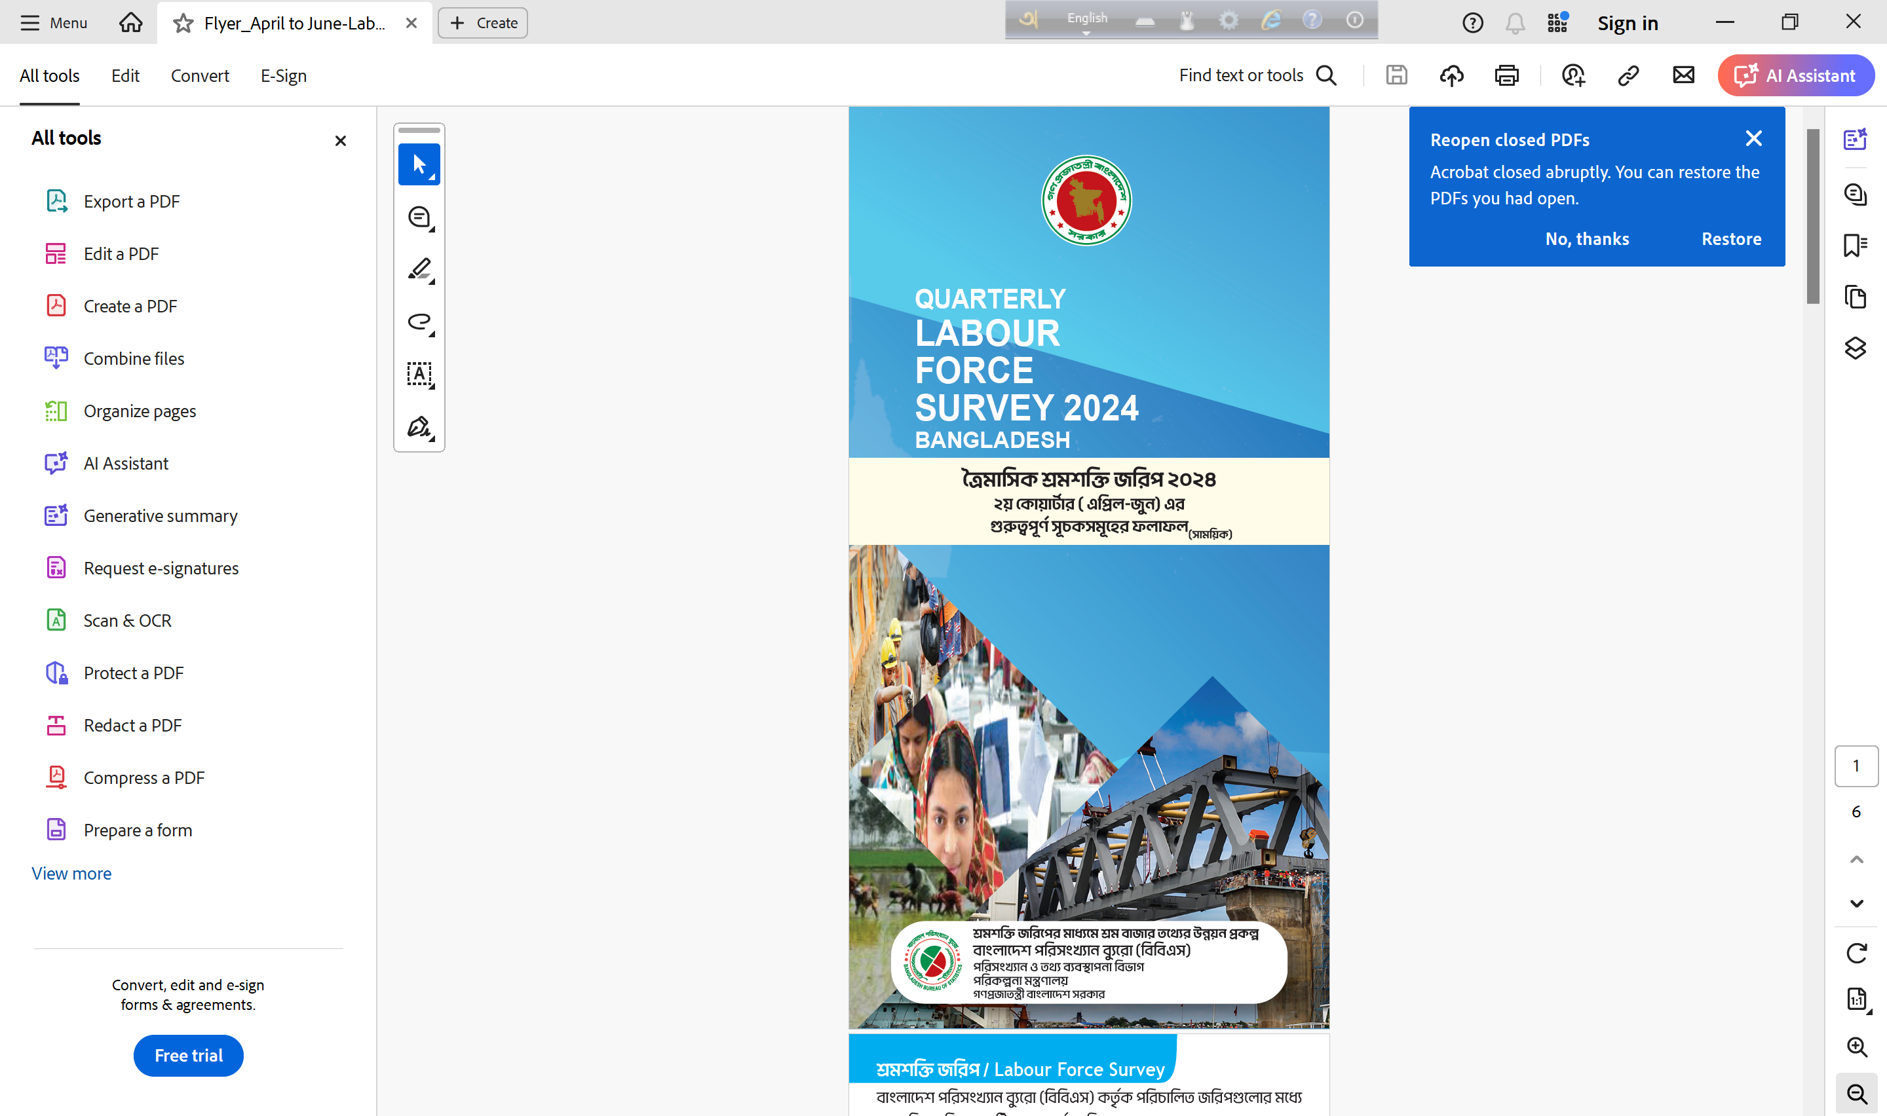
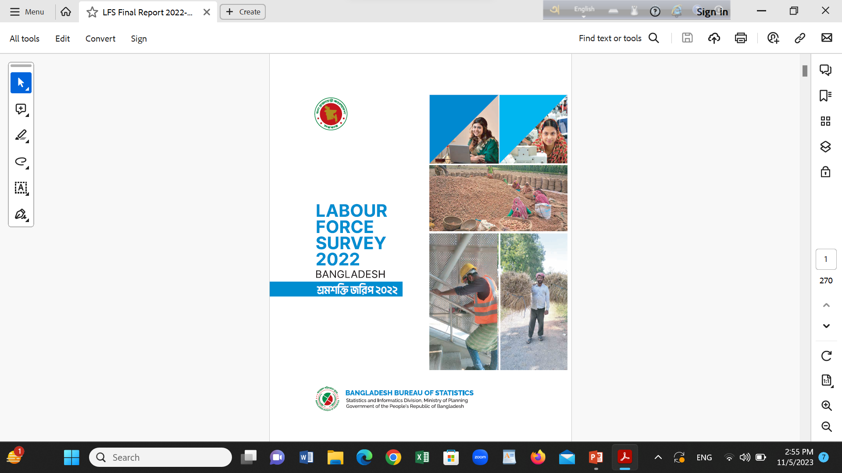
Focus and Thematic Areas
BBS conducts ‘Labor Force Survey 2022’ that provides information on the country's labour market such as employment, unemployment, employment by industry, employment by occupation, employment by job status, informal employment, youth labour force, labour force participation rates, average weekly working hours, monthly earnings etc.
It followed recommendations from the 19th International Conference of Labour Statisticians (ICLS) for ensuring global standard.
The survey includes a module on disability, using the 6-item Washington Group Short Set of Disability Questions (WGQ). This module has assessed individuals' functional difficulties in basic activities like walking, seeing, hearing, remembering, self-care, and communication aged 15 years and older population persons with disability.

Slide 5
Focus and Thematic Areas (Cont.)
Disability module in LFS Questionnaire
Section 1: Disability identification (all persons aged 15 years and over): 6 questions
Section 2: Barriers (For all aged 15 and over who are not in employment and have responded “A lot of difficulty” or “cannot do at all / unable to do” to at least one of question 1-6 : 2 questions
Section 3: social protection : (For all aged 15 and over who have responded ‘A lot of difficulty’ or ‘cannot do at all / unable to do’ to at least one of questions 1-6: 2 questions
Within these questions, persons face difficulties in at least one or two of the six activities and some find it impossible or challenging to work on these activities. For these reasons, two designated categories have been identified as functional difficulties or persons with disabilities. This classification helps to capture functional difficulties or persons with disabilities in the context of labour market dynamics.

Slide 6
Geographical Coverage
According to the Survey frame 1284 PSU (Primary Sampling Unit) selected for data collection where 24 HH (Household) from each PSU will be considered for conducting the interview. Finally, quarterly 30816 HH and all total in a year 1 lac 23 thousand and 264 HH covered for this survey.
Survey framed was used from Population and Housing Census 2022 enumeration area
Two-Stage Stratified Cluster Sampling followed for this Survey. Firstly, PSU have been selected and in the second stage, 24 households have been derived as a cluster of sampling for this Survey. Probability Selection considered in this process.
Two or Three Enumeration areas were merged to formulate the PSU where on average 200 HH exists for each PSU.
Providing the national estimates, rural and urban will covered from this survey through this sampling process.

Slide 7
Major Ongoing Initiatives/Projects
Compilation of disability statistics from the Population Census and other relevant surveys conducted by the Bangladesh Bureau of Statistics (BBS).
Regular generation of disability-related data through the Labour Force Survey.
Revision and enhancement of the disability module in the upcoming Labour Force Survey questionnaire.
Strengthening collaboration with relevant ministries and organizations throughout the survey process.

Slide 8
Key Achievement and Good Practices
Functional disability questionnaire introduced for the first time in the Labour Force Survey (LFS) in collaboration with ILO
ILO Geneva provided support in questionnaire design, data analysis, and training stages
A working group formed with representatives from BBS, ILO, and various OPD associations
The group worked intensively on technical details before presenting to the High-Level Committee
Two Residential Consultation Workshops held to finalize the questionnaire and identify key disability indicators
ILO conducted field supervision during data collection and implementation
A Key Findings Report on disability insights from LFS 2022 disseminated through a national workshop engaging all OPDs
After incorporating feedback, the Final Detailed Report on Disability Insights from LFS 2022 was officially released

Slide 9
Key Achievement and Good Practices (Cont.)
Overall, 33 lac 79 thousand people are disabled aged 15 years and older according to Labour Force Survey 2022 of which male is 53.62 % and female is 46.38%.
Among the disabled persons 37.11% is literate and the rest 62.89% is illiterate. This is true for male and female with higher number of illiterates among female.
Among the persons with disability, most of them are illiterate that is no class passed or not attained school (63.48%) followed by primary (17.43%), secondary (13.17%), higher secondary and tertiary level are same (2.72%) .

Slide 10
Key Achievement and Good Practices (Cont.)
The labour force with disabilities is not very significant. The disabled individuals at the national level was 761.53 thousand. Among the total male and female population, 1.24% are disabled male, and 0.69 thousand are disabled female which is observed lower for female disabled.
The percentage of employed disable population is 1.19% whereas it is 98.81% for persons without disability. These rates are much higher those who disable and not in labour force which is 5.65%.
Overall, 3.53% were unemployed, but with disabled population, the percentage is 1.63%, while for without disabled persons, it is 3.55%. For females, at the aggregate level, 3.59% are unemployed. On the other hand, for the disabled population, such rate is 1.93%, while it is 3.60% for without disabled.

Slide 11
Key Achievement and Good Practices (Cont.)
Among the employed population with disability the highest 54.56% were own account worker followed by employee (31.92%) and unpaid family worker (9.37%). Among the females, the highest 52.47% were own account worker followed by unpaid family worker (23.48%) and employee (21.76%).
As high as 52.16% with disabled persons are employed in agriculture sector followed by service (36.71%) and industry (11.13%).
At the national level only 12.81% with disabled persons are in the formal sector and such percentage for males and females are 15.74% and 3.13% respectively. All the rest are engaged in informal sector.
At the national level an employed persons with disability works for 38 hours in a week and 40 hours in the urban area and 36 hours in the rural area. For the males 44 hours worked per week is found at the national level and 46 hours and 42 hours respectively in urban and rural areas.
The average monthly income of a person with disability is TK 10470.01 at the national level, it is TK 11,552.72 in urban area and TK 9417.31 in the rural area. The males person with disabilities have higher monthly income than their female counterparts in the both urban and rural area.
The labour force participation rate of disabled person is only 22.54% and it was 32.22% for the males and 11.34% for females. The rate is much below the national labour force participation rate 61.20%.

Slide 12
Challenges and Lessons Learned
Identifying persons with functional difficulties from household is sometimes challenging;
Lack of coordination among other ministries and BBS, consequently disability data may be misleading.

Slide 13
Collaboration and Partnership
International Labour Organization (ILO)
Technical support in questionnaire design, training, analysis, and field supervision
Continuous collaboration in strengthening disability measurement in labour statistics
Government Ministries & Agencies
Active engagement of relevant ministries throughout the survey process
Joint efforts to ensure alignment with national disability policies and standards
Organizations of Persons with Disabilities (OPDs)
Meaningful participation in reviewing and refining the disability module
Valuable inputs in consultation workshops and dissemination events
Multi-Stakeholder Working Group
Established with representatives from BBS, ILO, and OPDs
Provided coordinated guidance and technical oversight

Slide 14
Way Forward
Harmonization with international aggregated concepts and definition in all surveys and censuses
01
Re-visit the global guidelines and relevant tools in upcoming surveys
02
Enhance coordination among ministries and departments regarding data
03
Extend support to BBS, where methodological improvement requires in LFS etc.
04

